Slide 1
//Welcome to
//Java I!

Slide 2
Who am I?
Andrew Cabey and Ryan Marten
Senior at the High School
Programmer on the school’s FRC team
Been programming for several years in several languages
andrewc@ussteam.org
me@acabey.xyz

Slide 3
Tell me a little about you?
What is your name?
What grade are you in?
Have you programmed before?
What languages have you used?
What is your favorite thing to do?

Slide 4
What is Java?
Aside from being one of the most widely used languages today, what does Java do for me?
“write once, run anywhere”
Who’s using Java anyways?

Slide 5
The modern world is written in Java
Billions lines of code written in Java
One of the top 3 programming languages for the past 16 years
Big Data, Small Data, My Data, Your Data

Slide 6
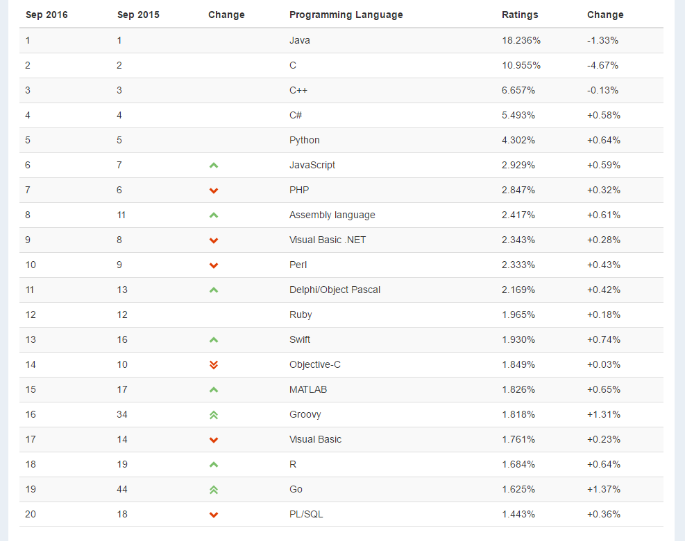

Slide 7
Designed to Run
Everywhere
Unlike other languages that have to be written for a specific type of computer, a single Java program will work on any machine
Java is cross-platform
The JVM

Slide 8
Logo Quiz
Each of these companies uses Java extensively
Do you know what they are?

Slide 9


Slide 10


Slide 11


Slide 12


Slide 13
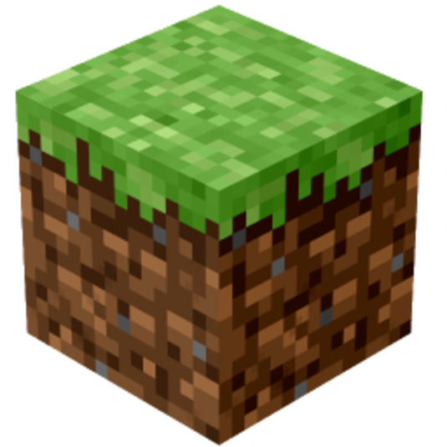

Slide 14



Slide 15
//What’s Coming

Slide 16
Topic | Objectives | Time Spent
Programming Environment | Students should understand and be able to navigate the tools required to make a Java program | 2 classes
Representing Simple Data | Students will be comfortable will all primitive types in Java and be able to choose how to represent real-world data | 1 class
Control Flow | Students will understand how a program will run and be able to control the order in which code is executed | 2 classes
Distributing Logic | Students will understand the purpose of and be comfortable implementing methods that serve a specific need | 1 class
Debugging | Students will be able to use the scientific method to find and correct errors in code | 1 class
Representing Complex Data | Students will understand the concept of reference types and will be able to programmatically represent complex data from the real-world | 3 classes
Relationships in Data | Students will understand and implement basic concepts of object-oriented programming and data abstraction | 2 classes
Final Project | TBD | 3 classes

Slide 17
Class Structure

Slide 18
You decide?
Projects
Projects
Projects

Slide 19
Git
Canvas

